Slide 1
5 hard challenges in IoT development
By Gerald Wakolbinger

Slide 2
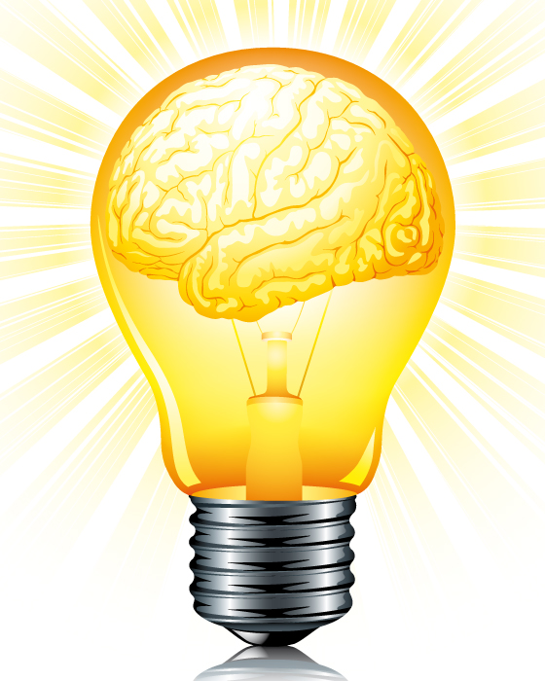
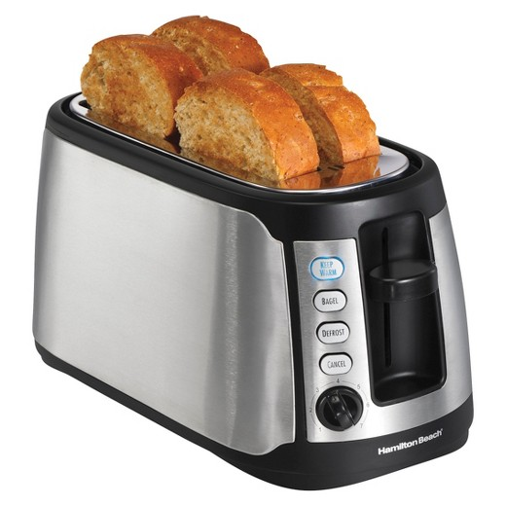
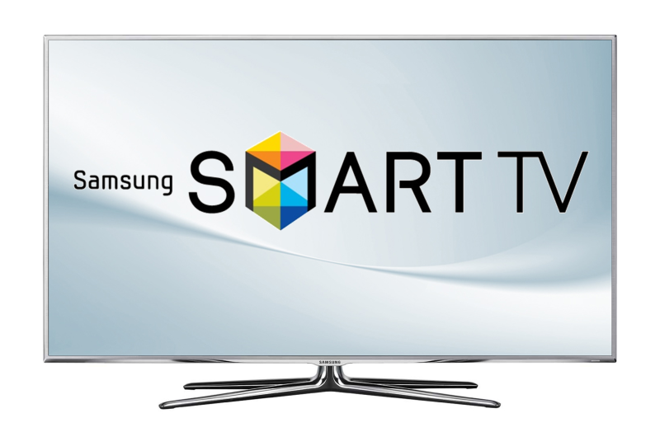
General
https://intl.target.com/c/toasters-kitchen-appliances-dining/-/N-5xtre
https://www.sine-wave.com/blog/smart-light-bulb#.WcPnaIy0OUk
https://gizmodo.com/samsungs-smart-tv-privacy-policy-raises-accusations-of-1684534051

Slide 3
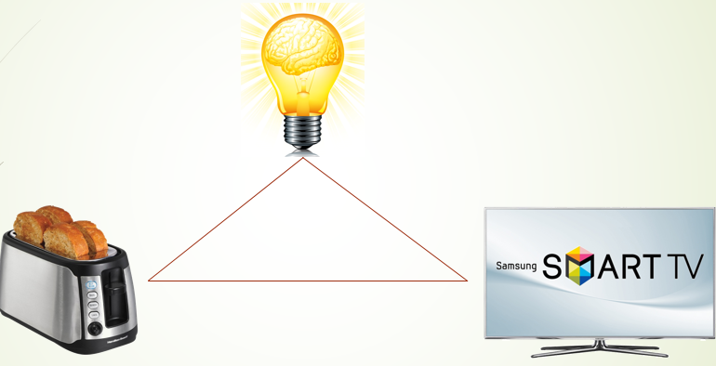
Hardware
High hardware requirements:
→ power supply and power consumption
→ Senors
→ Communication
→ Resources (CPU, RAM, etc.)

Slide 4

Scalability
Loads of Data
Storageoptions?
→ Big Data Solutions
→ Severfarms
→ etc.
https://impactcity.nl/topic/big-data/

Slide 5

Updates
IoT Device lifespan: 15-20 years
→ updates necessary
(security, bugfixes, etc.)
Difficult to install:
small memory
Short processing power
Not „shutdown-able“
http://www.dobson.net/all-patched-up-microsoft-security-update/

Slide 6
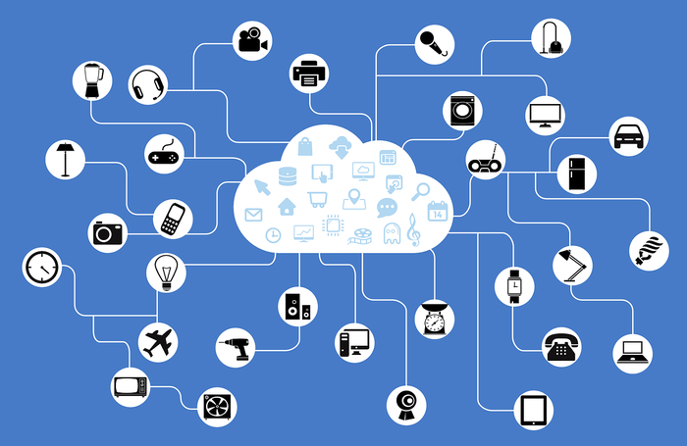
Interconnectivity
IoT booms in the last years
→ many devices (different companies)
not connectable
Standard needed
(e.g. communiaction and network protocols)
https://www.infoworld.com/article/3101170/internet-of-things/iots-big-challenge-managing-billions-of-devices.html

Slide 7
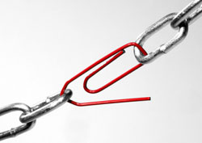
Security
https://ell.stackexchange.com/questions/132008/what-is-the-meaning-of-the-quote-a-chain-is-only-as-strong-as-its-weakest-link

Slide 8

Security
Reminder: very short on memory and CPU power
→ impossible to install anti-malware software
→vulnerable devices
http://www.itsecurityguru.org/2017/06/12/fireball-malware-become-next-mirai-2/

Slide 9

Security
Antimalwaresoftware solution found ✓
Still vulnerable to physical access ✗
http://www.moretricks.com/spying-on-someones-mobile-phone-without-physical-access

